Slide 1
Chemical energetics
5.1 Enthalpy change, ΔH
5.2 Hess’ law

Slide 2
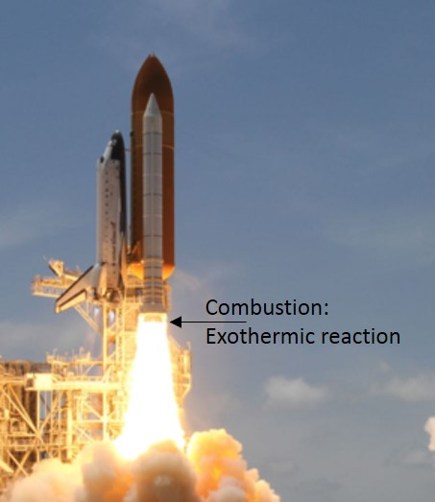
Introduction
Chemical reactions that release energy to the surroundings are called as exothermic reactions. For example: Combustion of fuels.
Chemical reactions that absorb energy from the surroundings are called as endothermic reactions. For example: photosynthesis.
Exothermic reaction

Slide 3
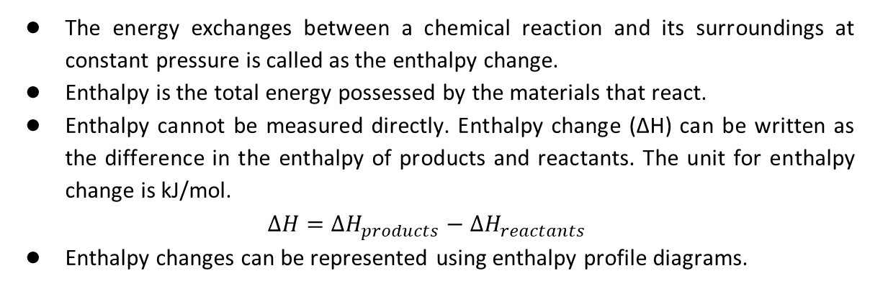
Enthalpy changes and enthalpy profile diagrams
The energy exchanges between a chemical reaction and its surroundings at constant pressure is called as the enthalpy change.
Enthalpy is the total energy possessed by the materials that react.
Enthalpy cannot be measured directly. Enthalpy change (ΔH) can be written as the difference in the enthalpy of products and reactants. The unit for enthalpy change is kJ/mol.
$$∆H={∆H}_{products}−{∆H}_{reactants}$$
Enthalpy changes can be represented using enthalpy profile diagrams.

Slide 4
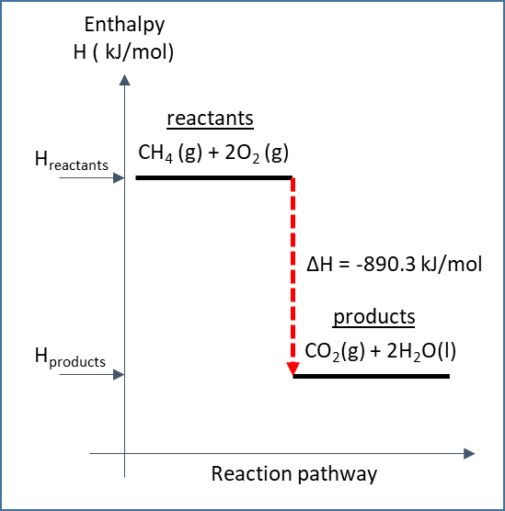
Enthalpy changes and enthalpy profile diagrams
The combustion of methane in the presence of excess oxygen is an exothermic reaction.
For exothermic reactions, the enthalpy change is negative as ΔH(products) < ΔH(reactants)
CH₄ (g) + 2O₂ (g) → CO₂(g) + 2H₂O(l)
ΔH=-890.3 kJ/mol
Enthalpy profile diagram of an exothermic reaction

Slide 5
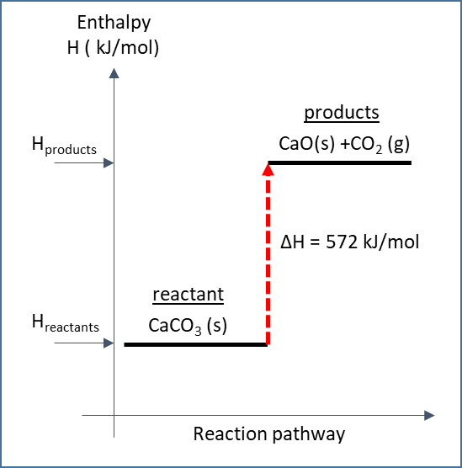
Enthalpy changes and enthalpy profile diagrams
Thermal decomposition of calcium carbonate is an endothermic reaction.
For endothermic reactions, the enthalpy change is positive as ΔH(products) > ΔH(reactants)
CaCO₃ (s)→ CaO(s) +CO₂ (g)
ΔH=572kJ/mol
Enthalpy profile diagram of an endothermic reaction

Slide 6
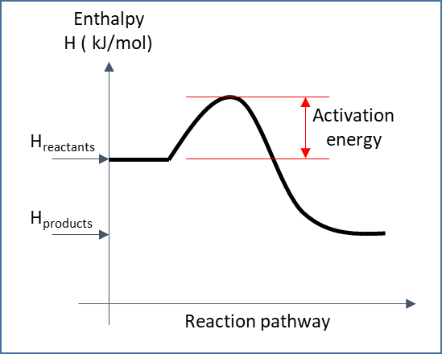
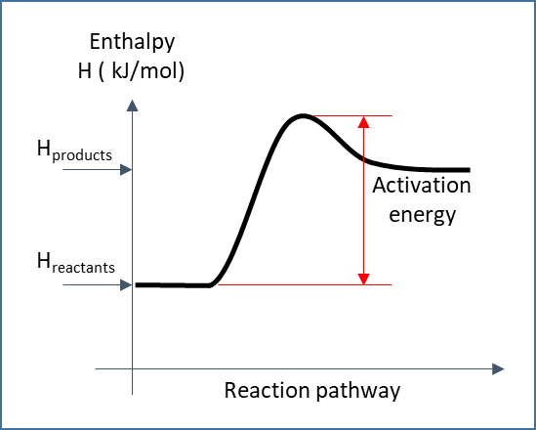
Activation energy
The minimum energy that colliding reactant particles must possess in order to start a reaction is called as activation energy.
Activation energy of exothermic reaction
Activation energy of endothermic reaction

Slide 7
Standard change of enthalpy
The standard conditions for measuring enthalpy changes are:
      Pressure of 100 kPa (normal atmospheric pressure)
      Temperature of 298 K (25 ⁰C)
      Reactants are in the normal physical state at 100 kPa and 298 K
      Solutions at a concentration of 1 mol/dm³
To denote that the enthalpy change has been calculated at standard pressure and temperature, symbol ⦵ is used.
CH₄ (g) + 2O₂ (g) → CO₂(g) + 2H₂O(l) ΔH⦵=-890.3 kJ/mol

Slide 8
Standard enthalpy change of reaction
The standard enthalpy change of a reaction is the enthalpy change when the amount of reactants shown in balanced equation at standard pressure and temperature react to give products at standard pressure and temperature.
2H₂ (g) +O₂ (g) →2H₂O (l) ΔH⦵_{r}=-572 kJ/mol

Slide 9
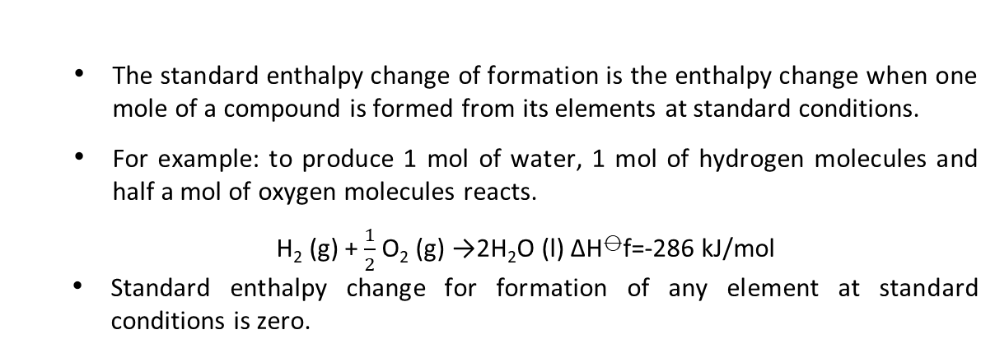
Standard enthalpy change of formation
The standard enthalpy change of formation is the enthalpy change when one mole of a compound is formed from its elements at standard conditions.
For example: to produce 1 mol of water, 1 mol of hydrogen molecules and half a mol of oxygen molecules reacts.
H₂ (g) + $\frac{1}{2}$O₂ (g) →2H₂O (l) ΔH⦵f=-286 kJ/mol
Standard enthalpy change for formation of any element at standard conditions is zero.

Slide 10
Standard enthalpy change of combustion
The standard enthalpy change of combustion is the enthalpy change when one mole of a substance is burnt in the presence of excess oxygen at standard conditions.
For example: the standard enthalpy change of combustion of sulphur is -296.8 kJ/mol.
S (s) + O₂ (g) → SO₂(g) ΔH⦵_{C} [S(s)]=-296.8 kJ/mol

Slide 11
Standard enthalpy change of neutralisation
The standard enthalpy change of neutralisation is the enthalpy change when 1 mol of water is formed when acid and alkali react under standard conditions.
For example:
HCl (aq) + NaOH (aq) → NaCl (aq) + H₂O (l) ΔH⦵_{n}=-57.1 kJ/mol

Slide 12
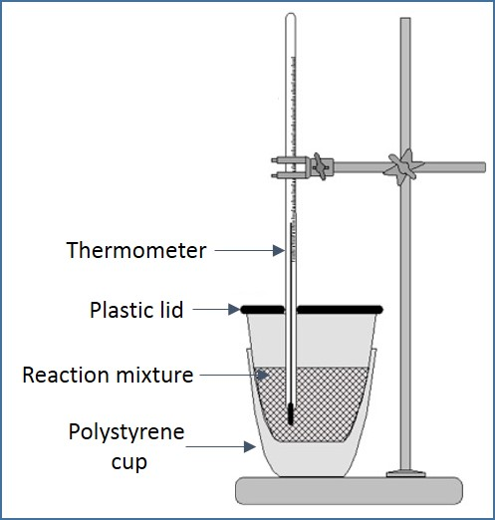
Measuring enthalpy changes experimentally using calorimetry
The apparatus used in calorimetry is called as calorimeter.
A polystyrene cup or vacuum flask can act as a calorimeter. Known amounts of reactants and known volumes of liquids are taken.
The temperature changes are measured using thermometer.
The enthalpy change is given by the equation,
ΔH=-mcΔT/ n
where m is the mass of water in grams, c is the specific heat capacity of water (4.18 J/g⁰C) and ΔT is the change in temperature in degree Celsius (⁰C). n is the amount of fuel burnt in moles.
Measuring enthalpy changes experimentally

Slide 13
Measuring enthalpy changes experimentally using calorimetry
In calorimetry, acids, alkalis and salts are assumed to consist of large amounts of water.
In case of solutions, it is assumed that 1 cm³ of solution has 1 g.
It is also assumed that the specific heat capacity of solutions is same as water.
Measuring enthalpy changes experimentally

Slide 14
Finding enthalpy change of neutralisation using calorimetry
Example 1: The enthalpy change of neutralisation of sodium hydroxide and hydrochloric acid is found using equimolar and equal volumes of hydrochloric acid and sodium hydroxide.
Measure 50 cm³ of 1.0 mol/dm³ hydrochloric acid in polystyrene cup and record its temperature.
Add 50 cm³ of 1.0 mol/dm³ sodium hydroxide (at same temperature of acid) into polystyrene cup.
Stir the mixture and record the highest temperature

Slide 15
Finding enthalpy change of neutralisation using calorimetry
Calculations:
Using the assumption that 1 cm³ =1g,
Mass of solution = 100 g (50 cm³ of HCl and 50 cm³ of NaOH)
Specific heat capacity = 4.18 J/ g ⁰C
Initial temperature of reactants = 21.1 ⁰C = 273 + 21.1 =294.1 K
Final temperature of products =27.6 ⁰C = 300.6 K
Change in temperature = 300.6 – 294.1 = 6.5 K
Heat energy released= -mcΔT= -100 × 4.18 × 6.5 = -2717 J
Negative sign shows that this reaction is exothermic.
50 cm³ of 1.0 mol/dm³ hydrochloric acid
50 cm³ of 1.0 mol/dm³ sodium hydroxide (at same temperature of acid)
Stir the mixture and record the highest temperature

Slide 16
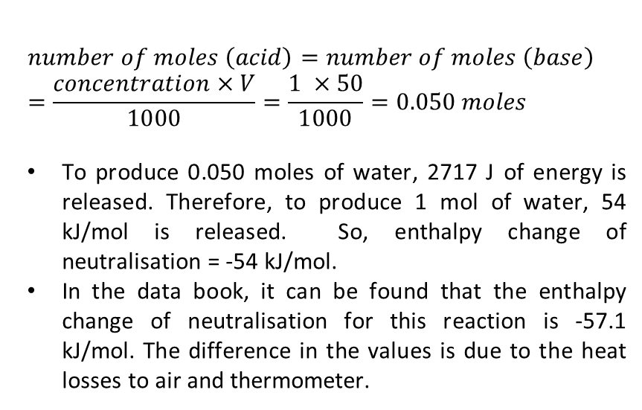
Finding enthalpy change of neutralisation using calorimetry
$$number of moles \left(acid\right)=number of moles \left(base\right)=\frac{concentration×V}{1000}=\frac{1 ×50}{1000}=0.050 moles$$
To produce 0.050 moles of water, 2717 J of energy is released. Therefore, to produce 1 mol of water, 54 kJ/mol is released. So, enthalpy change of neutralisation = -54 kJ/mol.
In the data book, it can be found that the enthalpy change of neutralisation for this reaction is -57.1 kJ/mol. The difference in the values is due to the heat losses to air and thermometer.
50 cm³ of 1.0 mol/dm³ hydrochloric acid
50 cm³ of 1.0 mol/dm³ sodium hydroxide (at same temperature of acid)
Stir the mixture and record the highest temperature

Slide 17
Bond enthalpies
To break bonds in a compound or a molecule requires energy to overcome the force of attraction.
When new bonds are created between atoms, energy is released. Hence, bond breaking is an endothermic reaction and bond making is an exothermic reaction.
A chemical reaction will be exothermic, if the energy needed to break bonds is less than the energy released when new bonds are formed. In this case, the reaction releases energy.
A chemical reaction will be endothermic, if the energy needed to break bonds is more than the energy released when new bonds are formed. In this case, the reaction absorbs energy.

Slide 18
Bond enthalpies
The amount energy required to break a specific covalent bond is called as bond enthalpy or bond energy. The symbol for bond enthalpy is E.
Consider O-H bonds in water. Relatively more energy is required to break the first O-H than the second. Moreover, O-H bonds of different compounds will require different bond energies.
Hence, the term average bond enthalpy is used where different bond energies of the same type of bond but in different environments are taken into consideration.

Slide 19
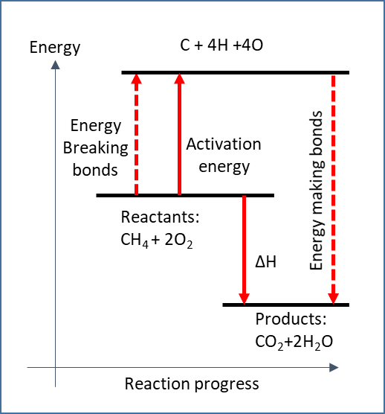
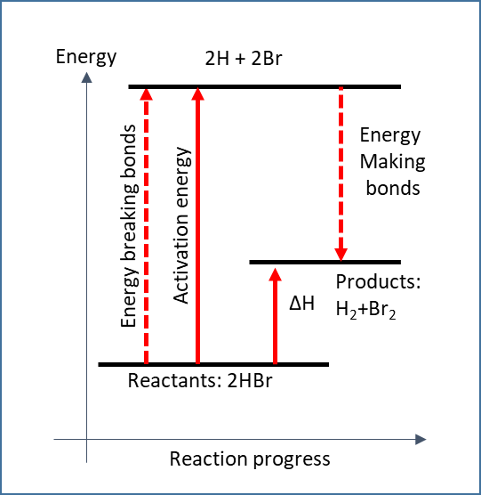
Bond enthalpies
Reaction profile of exothermic reaction (combustion of methane)
Reaction profile of endothermic reaction
(Decomposition of HBr)

Slide 20
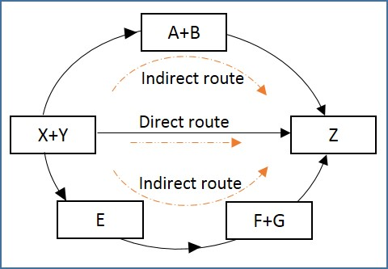
Hess’s law and enthalpy cycles
Hess’s law states that the total enthalpy change in a chemical reaction is independent of the route by which the chemical reaction takes place as long as the initial and final conditions are the same.
Consider reactants X and Y that combines directly to form product Z. This is the direct route. There are two indirect routes for this chemical reaction to take place:
X and Y combines to form A and B first and then, A and B combines to form Z.
X and Y combines to form E and then, E decomposes to F and G. F and G combine to form Z.
Using Hess’s law the enthalpy change of the reaction in direct route is same as that of indirect routes.
Enthalpy cycle

Slide 21
Hess’s law and enthalpy cycles
Calculating enthalpy change of formation from enthalpy changes of combustion
Example 2: Calculate the standard enthalpy change of formation of ethanol using the following data:
  ∆H⦵_{c}[C (s)]=-393.5 kJ/mol
  ∆H⦵_{c}[H₂(g)]=-285.8 kJ/mol
  ∆H⦵_{c}[C₂H₅OH (s)]=-1367.3 kJ/mol

Slide 22
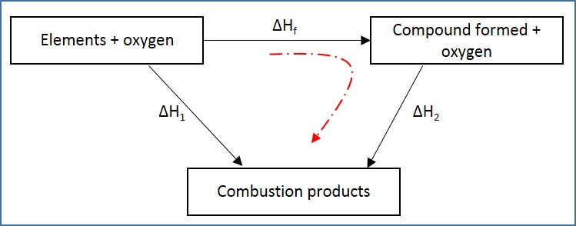
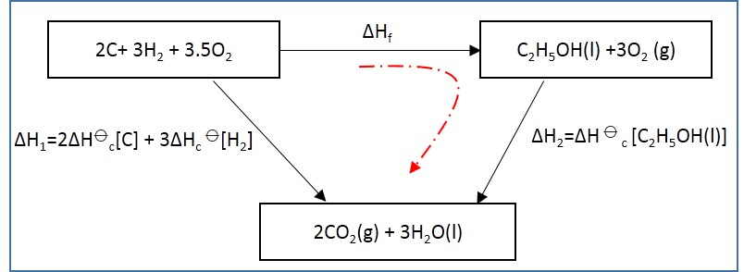
∆H_{f} from ∆H⦵_{c}
Calculate the standard enthalpy change of formation of ethanol using the following data:
∆H⦵f[C (s)]=-393.5 kJ/mol
∆H⦵f[H₂(g)]=-285.8 kJ/mol
∆H⦵c[C₂H₅OH (s)]=-1367.3 kJ/mol
The enthalpy change of formation is written on the top.
Oxygen is included to both the sides of the equation to balance combustion reactions.
The products of combustion are shown in the bottom.
Using Hess’s law,
  ∆H₁=∆H_{f} + ∆H₂
  ∆H_{f}= -1644.4+1367.3
  = -277.1 kJ/mol
Enthalpy cycle for combustion reaction
Enthalpy cycle for this combustion reaction

Slide 23
Hess’s law and enthalpy cycles
Calculating enthalpy change of reaction from enthalpy changes of formation
Example 3: Calculate the standard enthalpy change for the reaction:
2Al(s) +Fe₂O₃(s)→2Fe(s)+Al₂O₃(s)
The relevant enthalpy changes of formation are:
ΔH⦵_{f}[Fe₂O₃(s)]= -842.2 kJ/mol
ΔH⦵_{f}[Al₂O₃(s)]= -1675.7 kJ/mol

Slide 24
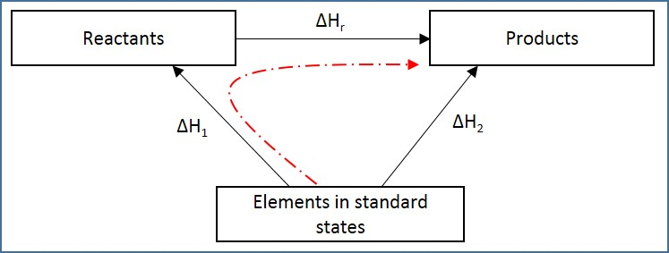
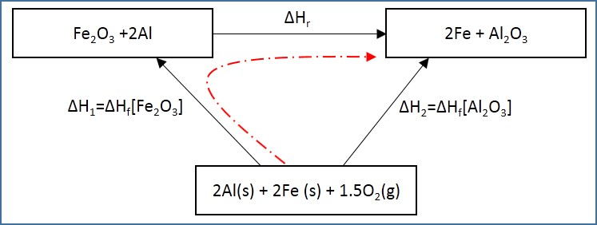
ΔH_{r} from ΔH⦵_{f}
Example 3: Calculate the standard enthalpy change for the reaction:
2Al(s) +Fe₂O₃(s)→2Fe(s)+Al₂O₃(s)
The relevant enthalpy changes of formation are:
ΔH⦵_{f}[Fe₂O₃(s)]= - 842.2 kJ/mol
ΔH⦵_{f}[Al₂O₃(s)]= -1675.7 kJ/mol
The balanced equation is written on top.
The elements are written in the bottom.
The dashed line shows the indirect route.
Using Hess’s law,
  ∆H₂=∆H₁+∆H_{r}
  ∆H⦵_{f}[Al₂O₃]=∆H⦵f[Fe₂O₃]+∆Hr
  -1675.7= - 842.2 + ∆Hr
  ∆Hr= - 833.5 kJ/mol
Enthalpy cycle for formation reaction
Enthalpy cycle for this reaction

Slide 25
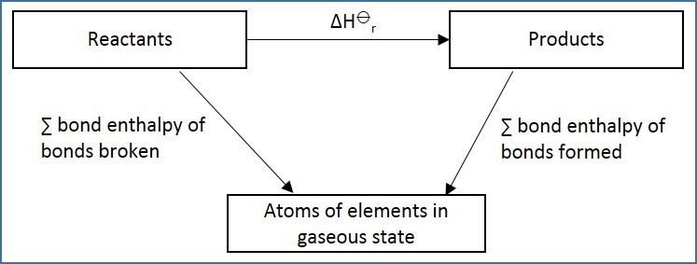
Calculating enthalpy changes of reaction using average bond enthalpies
In some reactions, the enthalpy change cannot be measured directly. In such reactions, mean bond enthalpy is used to calculate enthalpy change.
Using Hess’s law,
∆H_{r}=∑bond enthalpy of bonds broken - ∑bond enthalpy of bonds formed
However, this is only an accurate value because mean values of bond energies are used.
In order to find the exact value, we use enthalpy cycles where accurate values are used.
Enthalpy cycle for the reaction

Slide 26
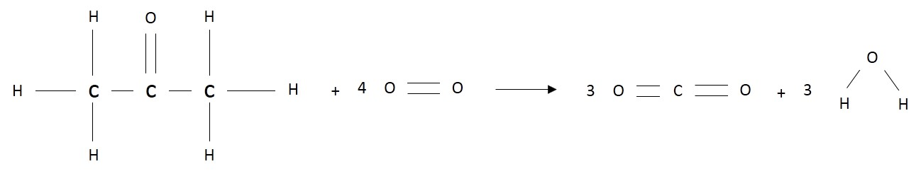
Calculating enthalpy changes using average bond enthalpies: Example
Example 4: Using the following data of bond enthalpies, calculate the standard enthalpy change of combustion of propanone (CH₃COCH₃)
E(C-C) =347 kJ/mol
E(C-H) =413 kJ/mol
E(O=O) =496 kJ/mol
E(C=O) =805 kJ/mol
E(O-H) =465 kJ/mol
Solution:
∆H=∑bond enthalpy of bonds broken-∑bond enthalpy of bonds formed
∆H= (6× E(C-H) + E(C=O) +2× E(C-C) + 4 × E(O=O)) - (6× E(C=O) +6× E(O-H))
=5961-7620
=-1659 kJ/mol

Slide 27
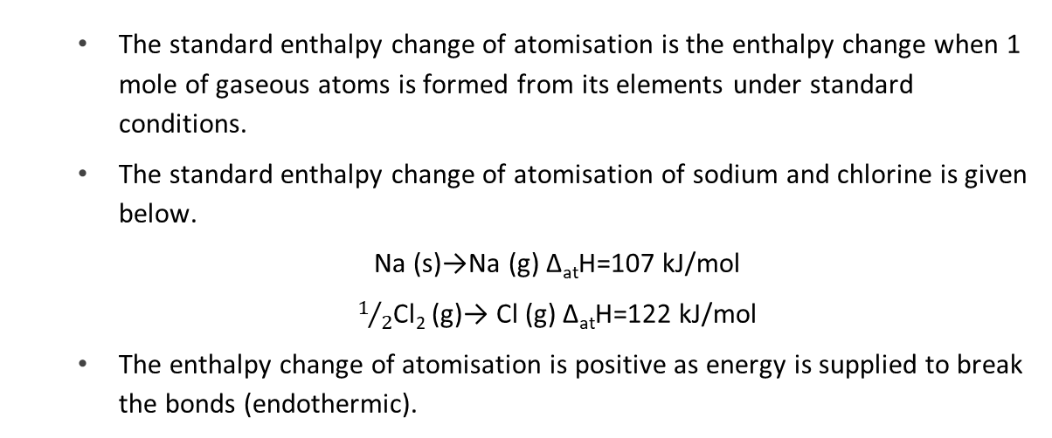
Standard enthalpy change of atomisation
The standard enthalpy change of atomisation is the enthalpy change when 1 mole of gaseous atoms is formed from its elements under standard conditions.
The standard enthalpy change of atomisation of sodium and chlorine is given below.
Na (s)→Na (g) Δ_{at}H=107 kJ/mol
$1/2$Cl₂ (g)→ Cl (g) Δ_{at}H=122 kJ/mol
The enthalpy change of atomisation is positive as energy is supplied to break the bonds (endothermic).

Slide 28
Standard enthalpy change of atomisation
When a solid breaks into its atoms, the following steps may take place:
  melting: standard enthalpy of fusion ΔH⦵_{m}
  vapourisation: standard enthalpy of vapourisation ΔH⦵_{vap}
  bonds breaking: sum of bond enthalpies
Therefore,
ΔH⦵_{at} = ΔH⦵_{m} + ΔH⦵_{vap} + bond energy terms
The standard enthalpy change of a compound is the enthalpy change to convert one mole of the substance in its standard state into gaseous atoms under standard conditions.

Slide 29
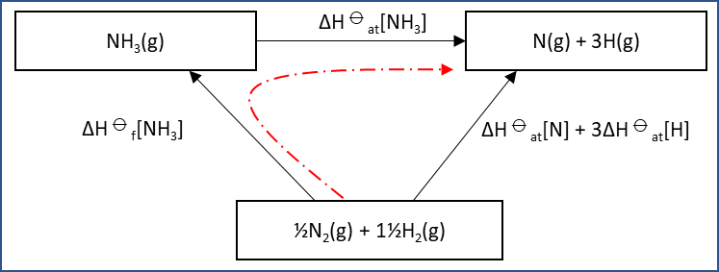
Calculating ∆H ⦵ _{at}[NH₃]
Calculating the enthalpy change of atomisation of ammonia, NH₃, using,
∆H ⦵ _{f}[NH₃] = -46.0 kJ/mol
∆H ⦵ _{at}[N] = 472.7 kJ/mol
∆H ⦵ _{at}[H] = 218.0 kJ/mol
∆H ⦵ _{f}[NH₃] + ∆H ⦵ _{at}[NH₃] = ∆H ⦵ _{at}[N] + 3 ∆H ⦵ _{at}[H]
-46.0 + ∆H ⦵ _{at}[NH₃] =472.7 + 3×218
∆H ⦵ _{at}[NH₃] = 1172.7 kJ/mol
Using the enthalpy change of atomisation, the average bond energy is found out,
E(N-H) is, 1172.7/3 = 390.9 kJ/mol
Enthalpy cycle for the reaction

Slide 30
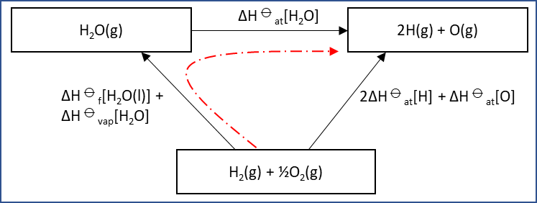
Calculating average bond energy of O-H bond in H₂O
∆H ⦵ _{f}[H₂O(l)] = -285.9 kJ/mol
∆H ⦵ _{vap}[H₂O] = +44.1 kJ/mol
∆H ⦵ _{at}[H] = +218.0 kJ/mol
∆H ⦵ _{at}[O] = +249.2 kJ/mol
Calculating enthalpy change of atomisation of H₂O,
∆H ⦵ _{f}[H₂O(l)] + ∆H ⦵ _{vap}[H₂O] + ∆H ⦵ _{at}[H₂O] = 2∆H ⦵ _{at}[H] + ∆H ⦵ _{at}[O]
-285.9 + 44.1 + ∆H ⦵ _{at}[H₂O] = 2×218 + 249.2
∆H ⦵ _{at}[H₂O] = 927 kJ/mol
The average bond energy, E(O-H) is, 927/2 = 463.5 kJ/mol
Because the bonds in H₂O needs to be broken in gaseous state, rather than in liquid state, which its standard state, we need to include the standard enthalpy change of vapourisation in our calculation.

